Slide 1


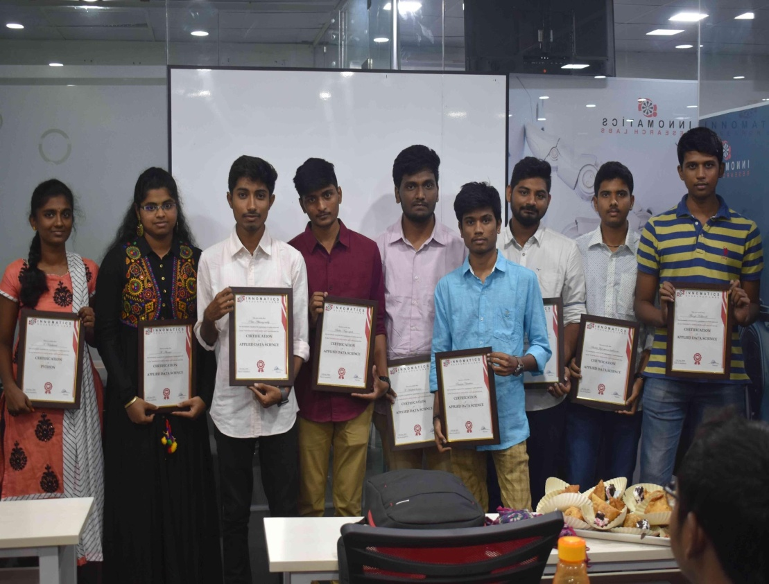



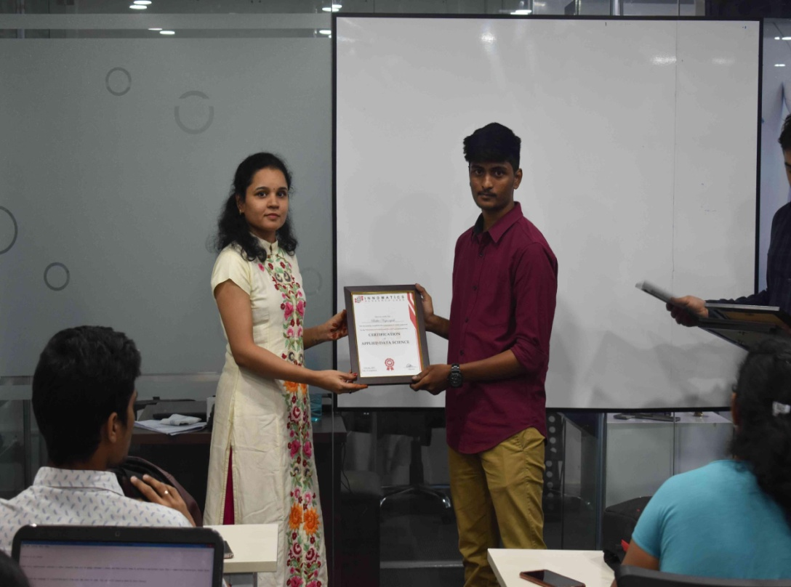
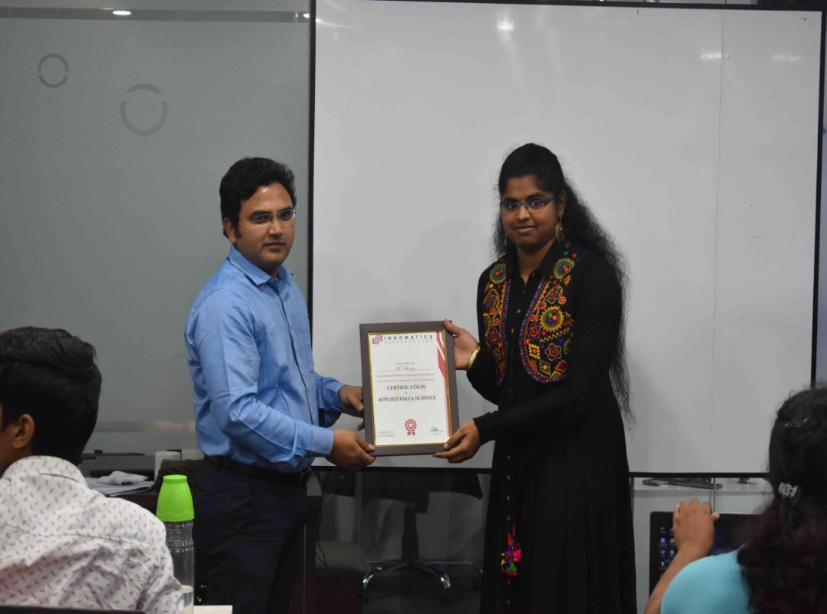

Slide 2
Market segment analysis of cars

Slide 3
About me
I’m vikas raj pursued my BBA from pragati mahavidyalaya degree college
I want to learn Data science because, while pursuing my BBA final year there was a subject called business analytics while studying that subject I came to know that I’m engrossed in analytics so I want to purse my career in Data analytics
I’m a fresher

Slide 4

WEB SCRAPPING AND EXPLORATORY DATA ANALYSIS ON

Slide 5
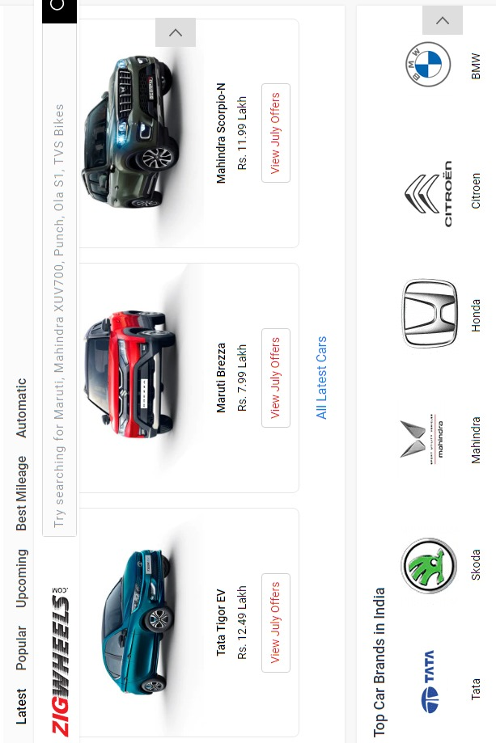
https://www.zigwheels.com

Slide 6
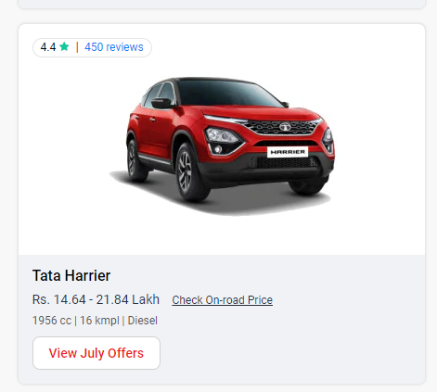
FEATURES:
Brand
Model
Variant type
CC
Gear Type
Boot Space
Price

Slide 7
IMPORTING THE LIBRARIES
Libraries:
Numpy
Pandas
Matplotlib
Seaborm
Requests
Bs 4/ Beautiful Soup
Re

Slide 8
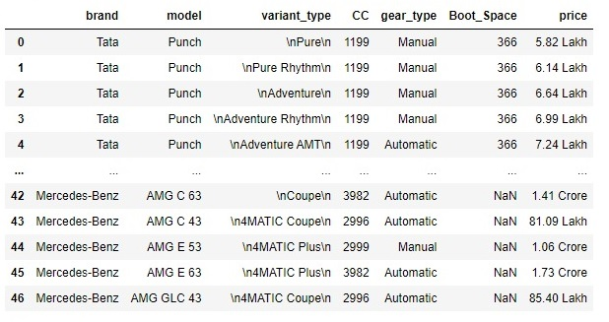
CREATION OF DATAFRAME

Slide 9
DATA CLEANING :
Identifying Null Values.
Identifying Missing Values.
Removing special characters.
Extracting required data from columns to create another columns using regular expressions.
Treating columns and converting required columns from object to int or float datatype.

Slide 10
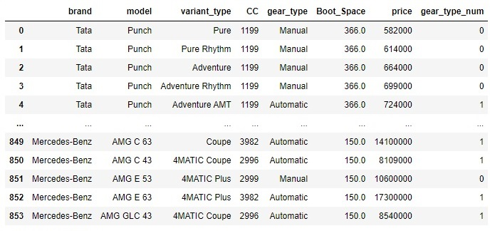
DATAFRAME AFTER CLEANING

Slide 11
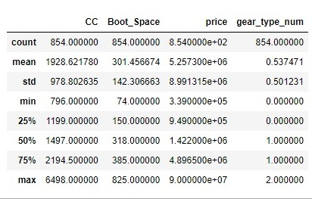
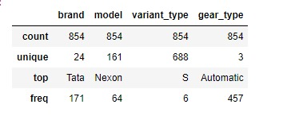
Summary statistics of Data Frame

Slide 12

VISUALIZATION :

Slide 13
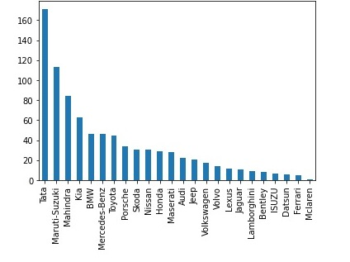
Number of models in each brands
observation
From the above plot we can conclude that Tata brand has more car models compare to the all brands and Maruti_Suzuki is in second place then followed by Mahindra and Mclaren have less varients compare to the all brands

Slide 14
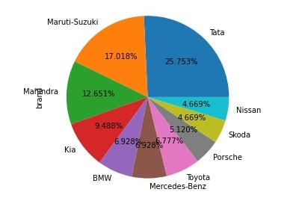
Market Percentage occupied by top ten brands cars
Observation
From the above observation we can conclude that in the top 10 brands Tata occupied 25.753% and then followed by maruti_suzuki and in 10 Th place Nissan

Slide 15
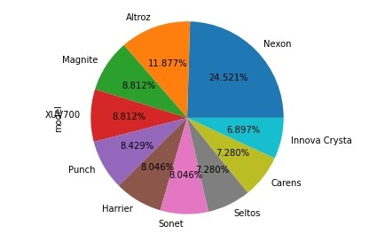
Market percentage occupied by top 10 models
observation
From the above observation we can conclude that in the top 10 brands Nexon occupied 24.521% and then followed by altroz with 11.877% and in 10 Th place innova crysta with 6.897%

Slide 16
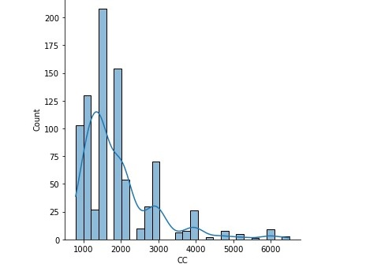
observation From this we can observe that maximum cars are in between 1000 to 2000 cc

Slide 17
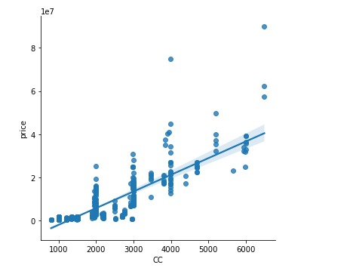
observation From the above plot we can conclude that if the cc increases then price will increase they both are positive correlation

Slide 18
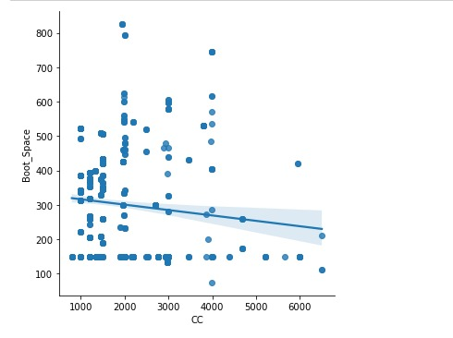
Observation From the above plot we can conclude that if the cc increases the boot space will decreases they both are negative correlation

Slide 19
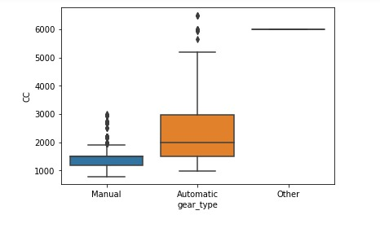
Observation cars above 2000 cc have less manual gear cars cars above 5000 cc have less auto gear cars

Slide 20
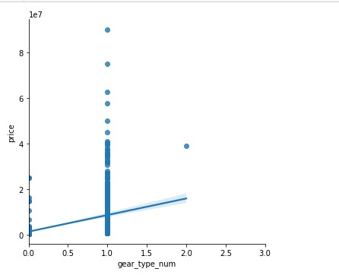
observation From the observation we can say that automatic cars are costly than manual cars and other cars

Slide 21
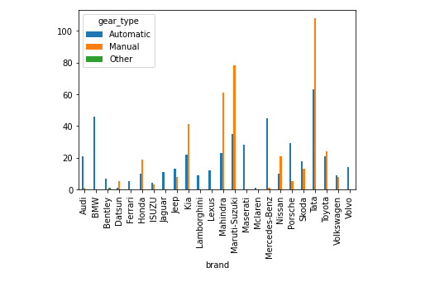
observation From above plot we can conclude that Tata brand has more manual cars, automatic cars and bmw, volvo, mclaren, Maserati, lexus,lamborghini and ferrari has no manual cars

Slide 22

THANK YOU

